Slide 1
LECTURE 2
OPERATING SYSTEMS

Slide 2
After this lecture, students should be able to:
Understand the role of the operating system.
Understand the process of bootstrapping to load the
operating system into memory.
List the components of an operating system.
Discuss the role of the memory manager.
Discuss the role of the process manager.
Discuss the role of the device manager.
Discuss the role of the file manager in an operating system.
Understand the main features of some common operating
systems: UNIX, Linux and Windows NT.

Slide 3
A computer is a system composed of two major components: hardware and software.
Computer hardware is the physical equipment.
Software is the collection of programs that allows the hardware to do its job.
Computer software is divided into two broad categories: the system software (operating system) and application programs.
Application programs use the computer hardware to solve users’ problems.
The system software, on the other hand, controls the access to hardware by users.

Slide 4
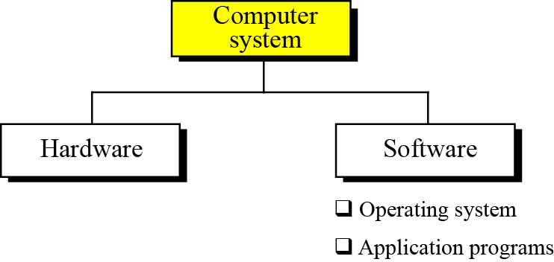
A computer system

Slide 5
INTRODUCTION
An operating system is complex, so it is difficult to give a simple universal definition. Instead, here are some common definitions:
An operating system is an interface between the hardware
of a computer and the user (programs or humans).
An operating system is a program (or a set of programs)
that facilitates the execution of other programs.
An operating system acts as a general manager supervising
the activity of each component in the computer system.

Slide 6

i
An operating system is an interface between the hardware of a computer and the user
(programs or humans)
that facilitates the execution of other programs
and the access to hardware and software resources.
Two major design goals of an operating system are:
❑ Efficient use of hardware.
❑ Ease of use of resources.

Slide 7
Bootstrap process
The operating system, based on the above definitions, provides supports for other programs. For example, it is responsible for loading other programs into memory for execution.
However, the operating system itself is a program that needs to be loaded into the memory and be run. How is this dilemma solved?
The solution is a two-stage process. A very small section of memory is made of ROM and holds a small program called the bootstrap program.
When the computer is turned on, the CPU counter is set to the first instruction of this bootstrap program and executes the instructions in this program.
When loading is done, the program counter is set to the first instruction of the operating system in RAM.

Slide 8
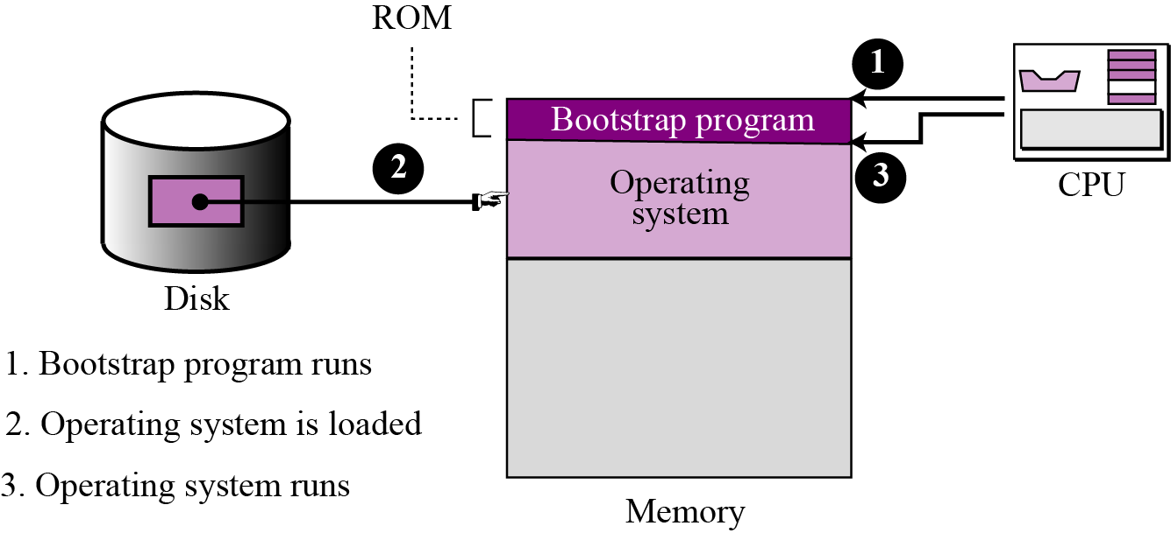
The bootstrap process

Slide 9
EVOLUTION
The evolution of operating systems went through seven major phases.
Six of them significantly changed the ways in which users accessed computers through the open shop, batch processing, multiprogramming, timesharing, personal computing, and distributed systems.
In the seventh phase the foundations of concurrent programming were developed and demonstrated in model operating systems.

Slide 10
Evolution of OS (contd..):
Major Phases | Technical Innovations | Operating Systems
Open Shop | The idea of OS | IBM 701 open shop (1954)
Batch Processing | Tape batching, First-in, first-out scheduling. | BKS system (1961)
Multi- programming | Processor multiplexing, Indivisible operations, Demand paging, Input/output spooling, Priority scheduling, Remote job entry | Atlas supervisor (1961), Exec II system (1966)
(Contd…)

Slide 11
Evolution of OS (contd..):
Timesharing | Simultaneous user interaction, On-line file systems | Multics file system (1965), Unix (1974)
Concurrent Programming | Hierarchical systems, Extensible kernels, Parallel programming concepts, Secure parallel languages | RC 4000 system (1969), 13 Venus system (1972), 14 Boss 2 system (1975).
Personal Computing | Graphic user interfaces | OS 6 (1972) Pilot system (1980)
Distributed Systems | Remote servers | WFS file server (1979) Unix United RPC (1982) 24 Amoeba system (1990)

Slide 12
EVOLUTION Contd:
Batch systems
Batch operating systems were designed in the 1950s to control mainframe computers.
At that time, computers were large machines that used punched cards for input, line printers for output and tape drives for secondary storage media.
Each program to be executed was called a job. A programmer who wished to execute a job sends a request to the operating system.

Slide 13
Time-sharing systems
The most pressing problem was the "waste" of CPU cycles when the single job in the computer's memory had to wait for an i/o transfer to complete.
To use computer system resources efficiently, multiprogramming was introduced. The idea was to hold several jobs in memory at a time, and only assign a resource to a job that needs it on condition that the resource is available.
Multiprogramming brought the idea of time sharing: resources could be shared between different jobs, with each job being allocated a portion of time to use a resource.
Because a computer is much faster than a human, time sharing is hidden from the user—each user has the impression that the whole system is serving them exclusively.

Slide 14
Personal systems
When personal computers were introduced, there was a need for an operating system for this new type of computer. During this era, single-user operating systems such as DOS (Disk Operating System) were introduced.
Parallel systems
The need for more speed and efficiency led to the design of parallel systems: multiple CPUs on the same machine.
Each CPU can be used to serve one program or a part of a program, which means that many tasks can be accomplished in parallel instead of serially. The operating systems required for this are more complex than those that support single CPUs.

Slide 15
Distributed systems
Networking and internetworking, created a new dimension in operating systems. A job that was previously done on one computer can now be shared between computers that may be thousands of miles apart. Distributed systems combine features of the previous generation with new duties such as controlling security.
Real-time systems
A real-time system is expected to do a task within a specific time constraint. They are used with real-time applications, which monitor, respond to or control external processes or environments.

Slide 16
COMPONENTS
Today’s operating systems are very complex.
An operating system needs to manage different resources in a computer system.
It resembles an organization with several managers at the top level.
Each manager is responsible for managing their department, but also needs to cooperate with others and coordinate activities.
A modern operating system has at least four duties: memory manager, process manager, device manager and file manager.

Slide 17
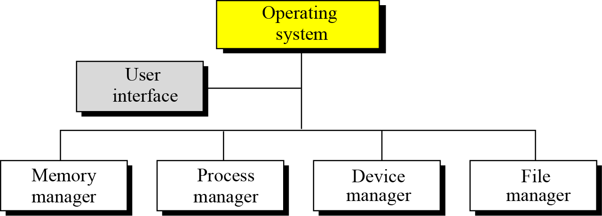
Components of an operating system

Slide 18
User interface
Each operating system has a user interface i.e. a program that accepts requests from users (processes) and interprets them for the rest of the operating system.
A user interface in some operating systems, such as UNIX, is called a shell.
In others, it is called a window to denote that it is menu driven and has a GUI (graphical user interface) component.

Slide 19
Memory manager
One of the responsibilities of a modern computer system is memory management.
Although the memory size of computers has increased tremendously in recent years, so has the size of the programs and data to be processed. Memory allocation must be managed to prevent applications from running out of memory.
Operating systems can be divided into two broad categories of memory management: monoprogramming and multiprogramming.

Slide 20
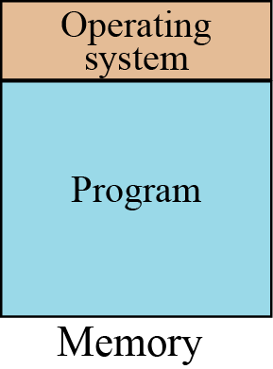
Monoprogramming
In monoprogramming, most of the memory capacity is dedicated to a single program; only a small part is needed to hold the operating system.
In this configuration, the whole program is in memory for execution. When the program finishes running, the program area is occupied by another program.
Monoprogramming

Slide 21
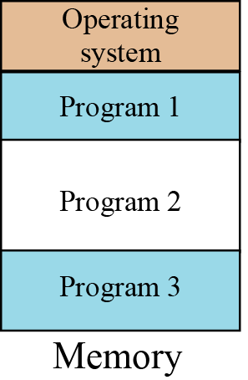
Multiprogramming
In multiprogramming, more than one program is in memory at the same time, and they are executed concurrently, with the CPU switching rapidly between the programs.
Multiprogramming

Slide 22
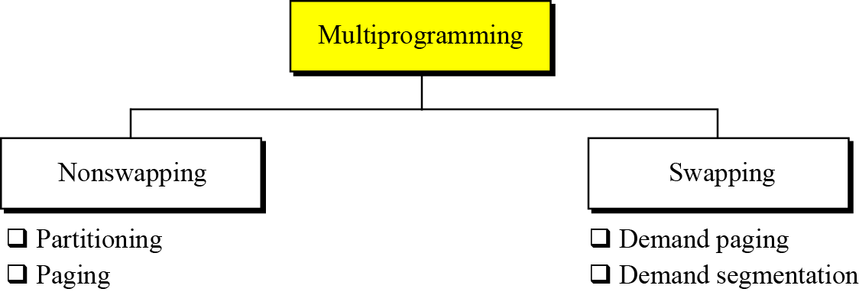
Advantages:
Efficient memory utilization
Throughput increases i. e. number of processes that complete their execution per unit time.
CPU is never idle, so performance increases.
Categories of multiprogramming

Slide 23
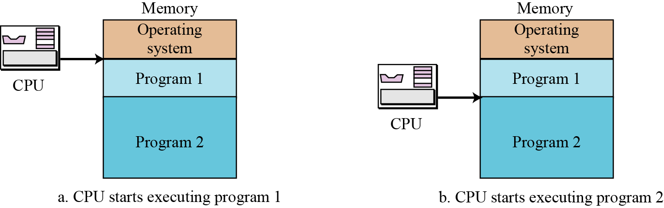
Partitioning

Slide 24
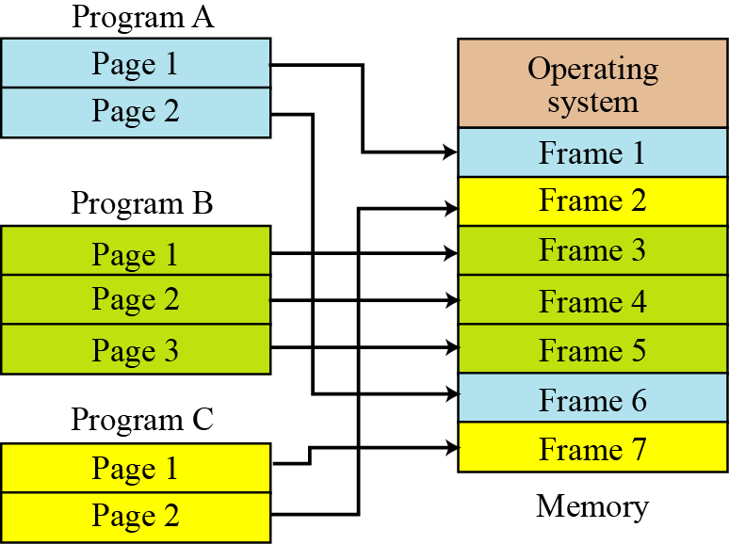
Paging

Slide 25
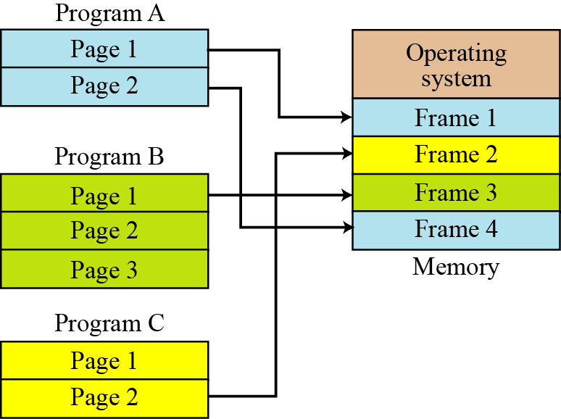
Demand paging

Slide 26
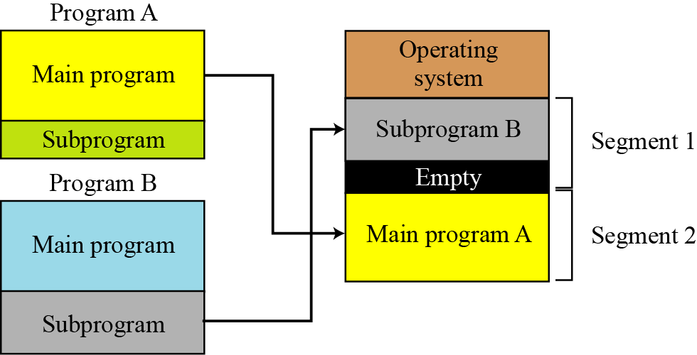
Demand segmentation

Slide 27
Virtual memory
Demand paging and demand segmentation mean that, when a program is being executed, part of the program is in memory and part is on disk.
This means that, for example, a memory size of 10 MB can execute 10 programs, each of size 3 MB, for a total of 30 MB. At any moment, 10 MB of the 10 programs are in memory and 20 MB are on disk.
There is therefore an actual memory size of 10 MB, but a virtual memory size of 30 MB.
Virtual memory, which implies demand paging, demand segmentation or both, is used in almost all operating systems today.

Slide 28
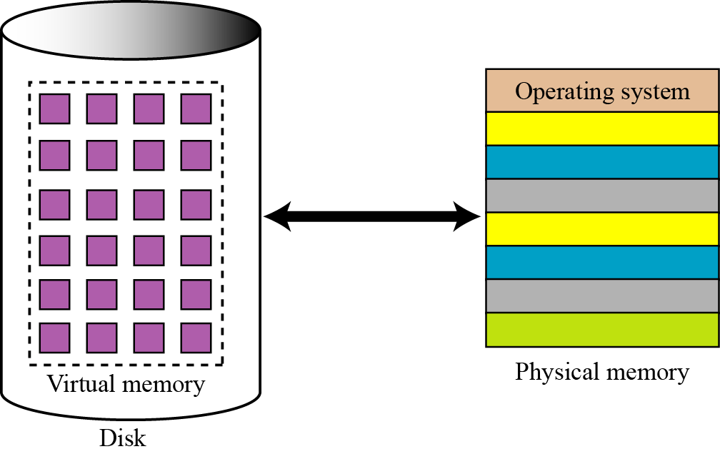
Virtual memory

Slide 29
Process manager
A second function of an operating system is process management, but before discussing this concept, we need to define some terms.
Program, job, and process
A program is a non-active set of instructions stored on disk.
A program becomes a job from the moment it is selected for
execution until it has finished running and becomes a program
again.
A process is a program in execution. It is a program that has started
but has not finished.

Slide 30
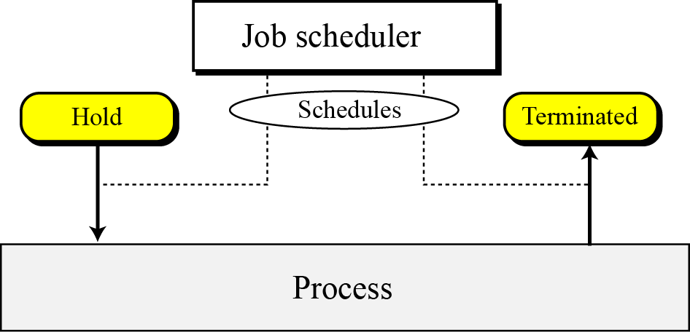
Schedulers
To move a job or process from one state to another, the process manager uses two schedulers: the job scheduler and the process scheduler.
Job scheduler

Slide 31
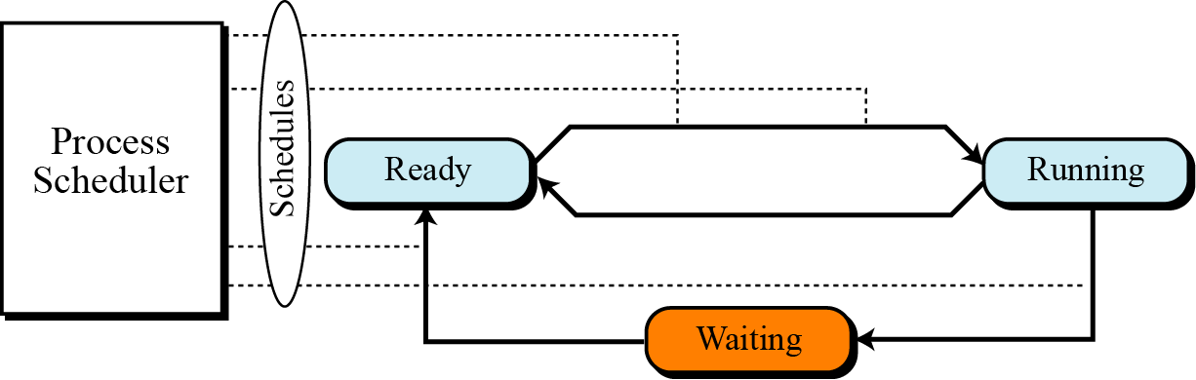
Process scheduler

Slide 32
Queuing
Our state diagram shows one job or process moving from one state to another. In reality, there are many jobs and many processes competing with each other for computer resources.
To handle multiple processes and jobs, the process manager uses queues (waiting lists).
A job control block or process control block is associated with each job or process. This is a block of memory that stores information about that job or process. The process manager stores the job or process control block in the queues instead of the job or process itself.

Slide 33
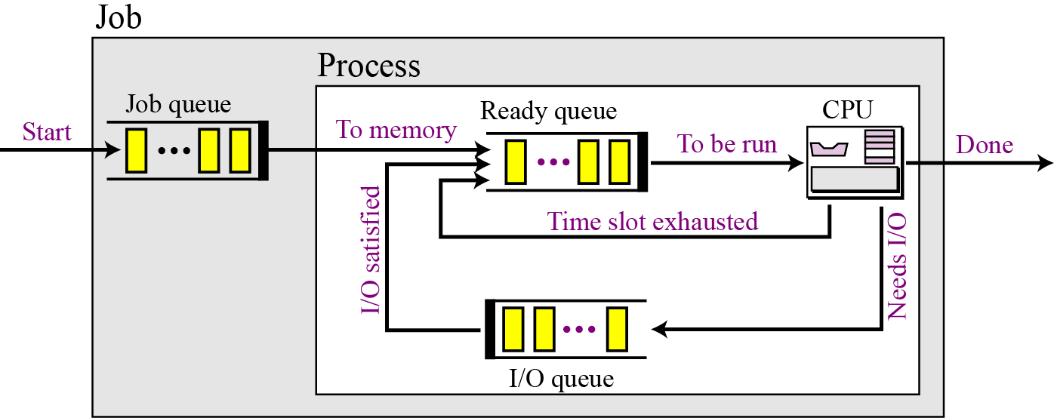
Queues for process management

Slide 34
Process synchronization
The whole idea behind process management is to synchronize different processes with different resources.
Whenever resources can be used by more than one user
(or process, in this case), we can have two problematic situations: deadlock and starvation.
7.<number>

Slide 35
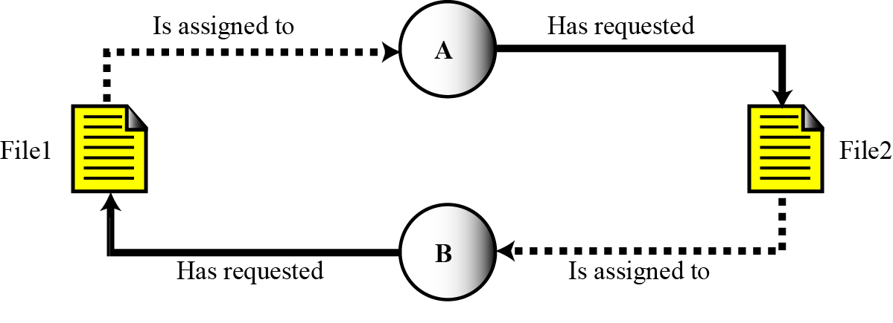
Deadlock
i
Deadlock occurs when the operating system does not
put resource restrictions on processes.

Slide 36
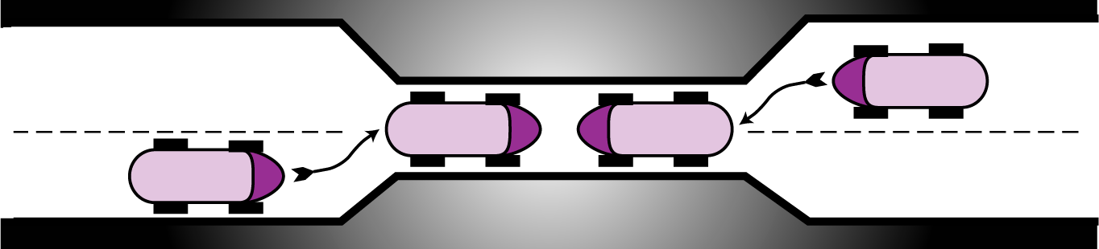
Deadlock on a bridge

Slide 37
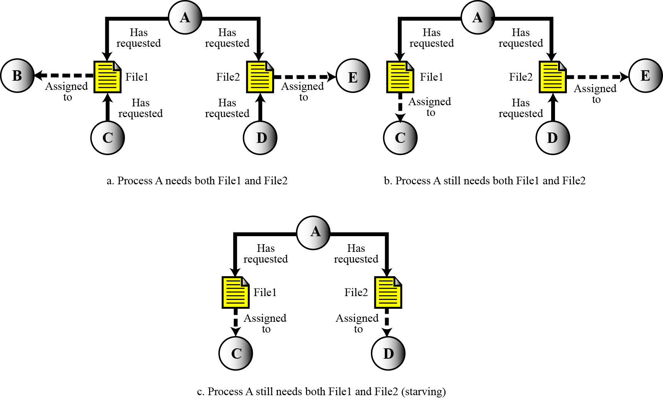
Starvation

Slide 38
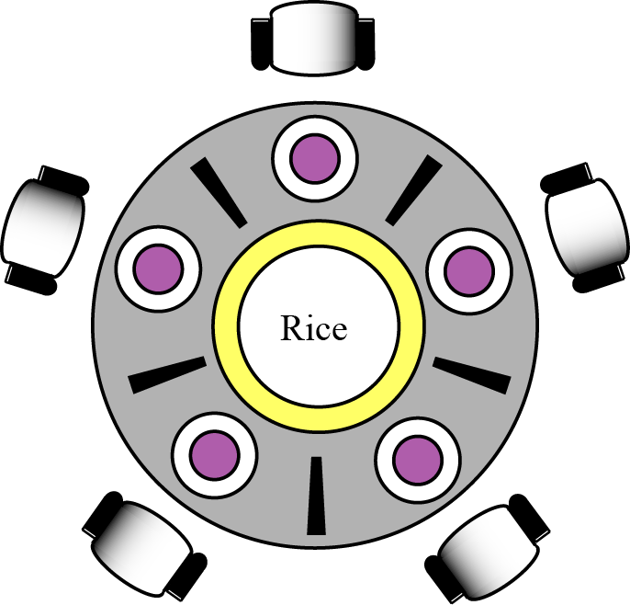
The dining philosophers problem
i
Starvation is the opposite of deadlock. It can happen when the operating system puts too many resource restrictions on a process.

Slide 39
Device manager
The device manager, or input/output manager, is responsible for access to input/ output devices. There are limitations on the number and speed of input/output devices in a computer system.
The device manager monitors every input/output device
constantly to ensure that the device is functioning properly.
The device manager maintains a queue for each input/output
device or one or more queues for similar input/output devices.
The device manager controls the different policies for accessing
input/output devices.

Slide 40
File manager
Operating systems today use a file manager to control access to files. A detailed discussion of the file manager also requires advanced knowledge of operating system principles and file access concepts that are beyond the scope of this course. The file manager:
controls access to files.
supervises the creation, deletion, and modification of files.
controls the naming of files.
supervises the storage of files.
is responsible for archiving and backups.

Slide 41
A SURVEY OF OPERATING SYSTEMS
In this section we introduce some popular operating systems and encourage you to study them further. We have chosen three operating systems that are familiar to most computer users: UNIX, Linux and Windows.

Slide 42
UNIX
UNIX was originally developed in 1969 by Thomson and Ritchie of the Computer Science Research Group at Bell Laboratories.
UNIX has gone through many versions since then. It has been a popular operating system among computer programmers and computer scientists.
i
UNIX is a multiuser, multiprocessing, portable operating system.
It is designed to facilitate programming, text processing and communication.

Slide 43
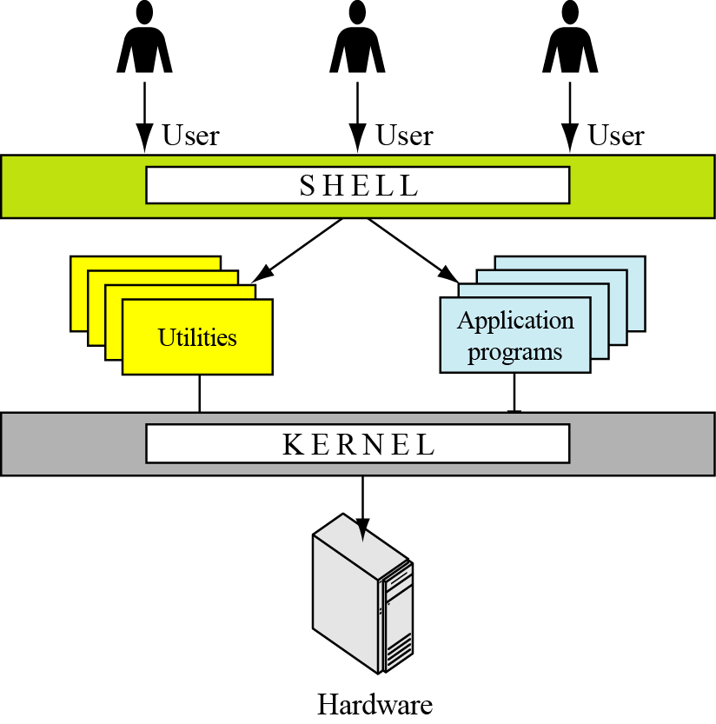
Components of the UNIX operating system

Slide 44
Linux
In 1991, Linus Torvalds, a Finish student at the University of Helsinki at the time, developed a new operating system that is known today as Linux.
The initial kernel, which was similar to a small subset of UNIX, has grown into a full-scale operating system today.
A kernel is a central component of an operating system.
The Linux 2.0 kernel, released in 1997, was accepted as a commercial operating system: it has all features traditionally attributed to UNIX.

Slide 45
Windows NT/2000/XP
In the late 1980s Microsoft, under the leadership of Dave Cutler, started development of a new single-user operating system to replace MS-DOS (Microsoft Disk Operating System).
Windows NT (NT standing for New Technology) was the result. Several versions of Windows NT followed and the name was changed to Windows 2000.
Windows XP (XP stands for eXPerience) was released in 2001. We refer to all of these versions as Windows NT or just NT.

Slide 46
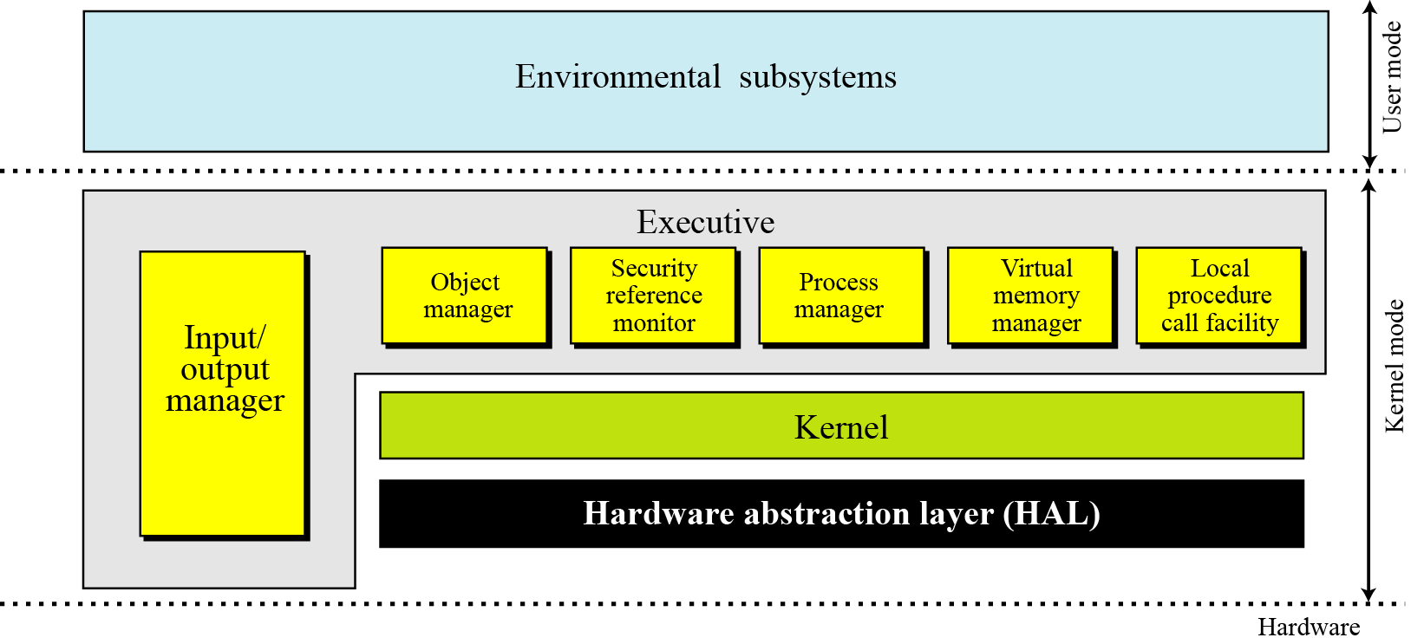
The architecture of Windows NT

